Slide 1


Uniq
College Info Reimagined

Slide 2


Problem

Slide 3
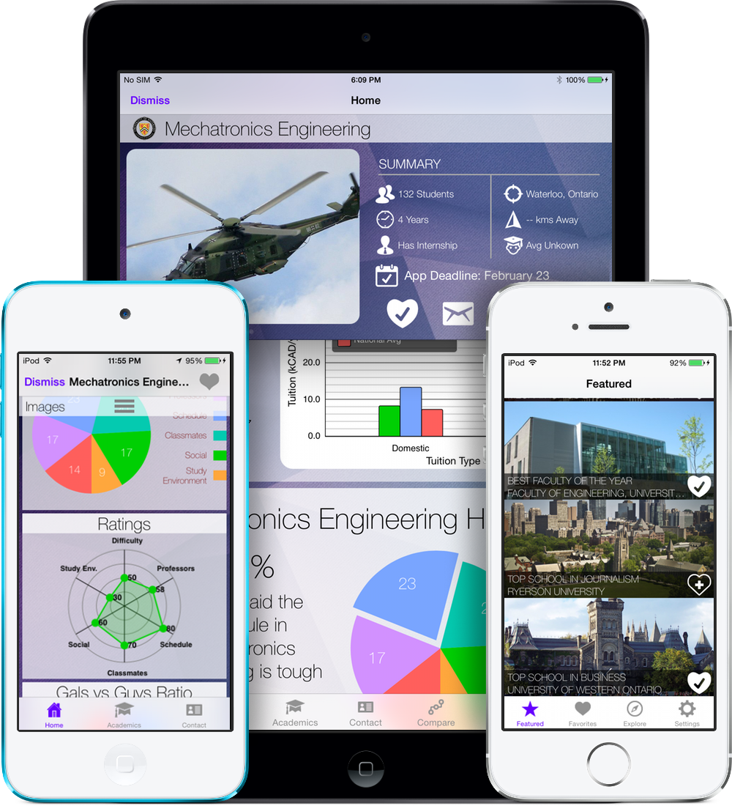

Uniq

Slide 4
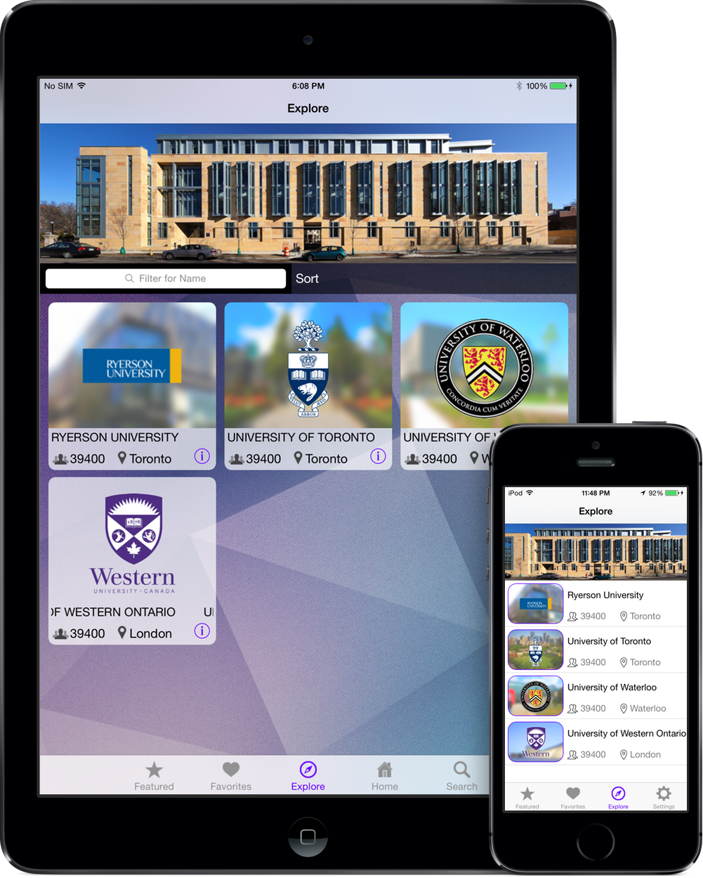
What is Uniq?
Personal Assistant for Colleges
Smart
Personal
Lightning Fast

Slide 5

Smart Search
Voice Enabled
Natural Language
Instant Answers

Slide 6
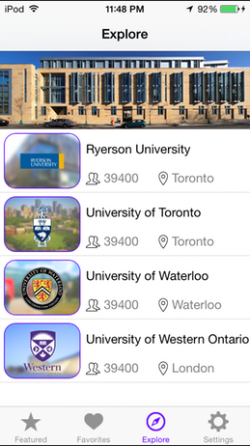
Explore
Minimalistic
Elegant
Intuitive

Slide 7
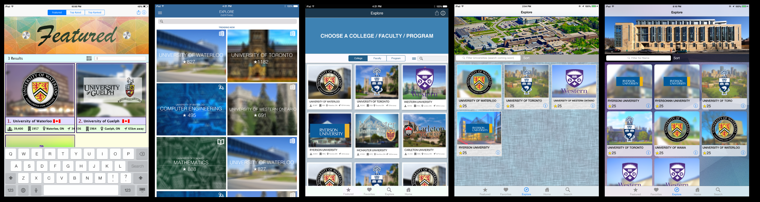
Design Iterations

Slide 8




Custom Server & Database

Slide 9

Powerful Features
Personal Suggestions
Push Notification
Offline access
Application Progress
Program Ratings
Program Comparison
More...

Slide 10
1,680,000
Total Enrollment in Canada

Slide 11
Survey
158 responses

Slide 12
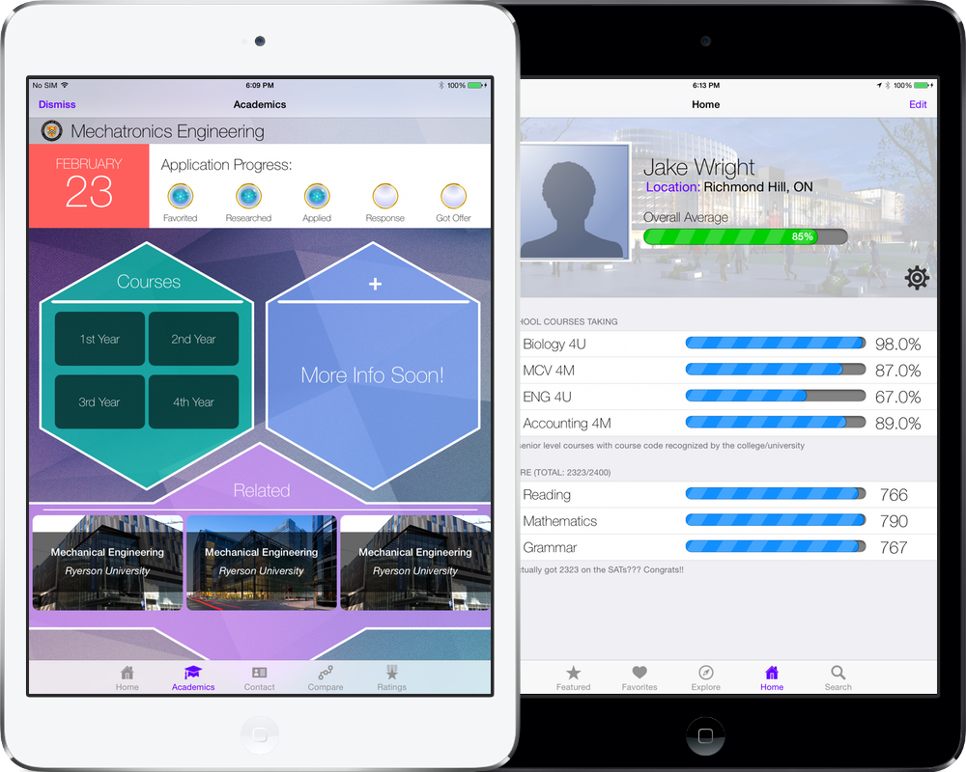
Potential

Slide 13
TEAM Uniq!
Jake Feng: 2B Mechatronics Engineering, UW
Christopher Luc: 2A Software Engineering, UW
Richard Lee: Graphics Design, George Brown
Andre Lee: 2B Mechatronics Engineering, UW
Aaron Te: 2B Computer Engineering, UW

Slide 14
Uniq
College Info Reimagined

Slide 15
Uniq
Website: uniq.url.ph
E-mail: technochimera@gmail.com
Twitter: @uniqios

